Slide 1
Climate Smart Land Stewardship Grant Program
January 10, 2024
https://ctconservation.org/programs/climate-smart/
Notes:
Introduction to CLCC:
Convener of the land conservation community through networking and collaborative programs, as well as annual conference
Provider of timely, practical, and affordable opportunities to build organizational capacity
Provider of direct technical assistance and conservation information.
Advocate for the land conservation community and leader on on policies related to conservation issues
Grantmaker to the land trust community through programs like this, TAG, and CCPP.
Housekeeping:
Put questions in the chat and we will get to them at the end - can also hold your question until the end for open Q&A
We will be recording, and will make the recording available within a few days, on the grant webpage.

Slide 2
Funding for this project was paid for by the
Climate Smart Farming: Agriculture and Forestry Grant.
Funding awarded and administered by the
Connecticut Department of Agriculture.
Notes:
First time program was offered through DoAg - $7MM available. 78 applicants requested more than $55MM. CLCC was one of 12 applicants to be awarded.
CLCC received $750,000. $500,000 will be regranted, remainder will support outreach, technical assistance, and administration of grant program. CLCC provided a $100,000 match.
Other regrant programs being offered by:
UConn Extension
New Connecticut Farmer Alliance
Northwest Connecticut Land Conservancy
Connecticut Resource Conservation & Development, Inc.
May be a better fit for your project, so worth looking at all options.

Slide 3
Agenda
Introduction
Program Goals
Overview of Grant Guidance
Sample Projects
Resources
Questions & Answers

Slide 4
Introductions
Aaron Lefland - Deputy Director
Ricky Bentley - Climate Smart Stewardship Coordinator
Julia Solomon - Shadbush Consulting

Slide 5
Introductions - Project Partners
Service Forestry Program
Kip Kolesinskas
Consulting Conservation Scientist

Slide 6
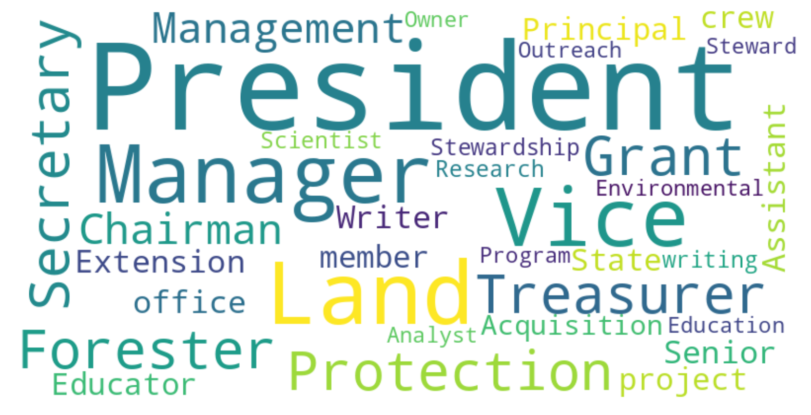
Introductions - YOU

Slide 7
Program Goals
Increase the capacity of Connecticut land trusts to manage their lands using climate smart land stewardship practices
Increase number of acres managed using climate smart practices
Encourage future use of climate smart practices among Connecticut’s land trusts
Elevate the role of conserved lands as part of the climate change solution
Notes:
120 land trusts have collectively conserved 200,000+ acres of land – maximize their impact as natural climate solutions

Slide 8
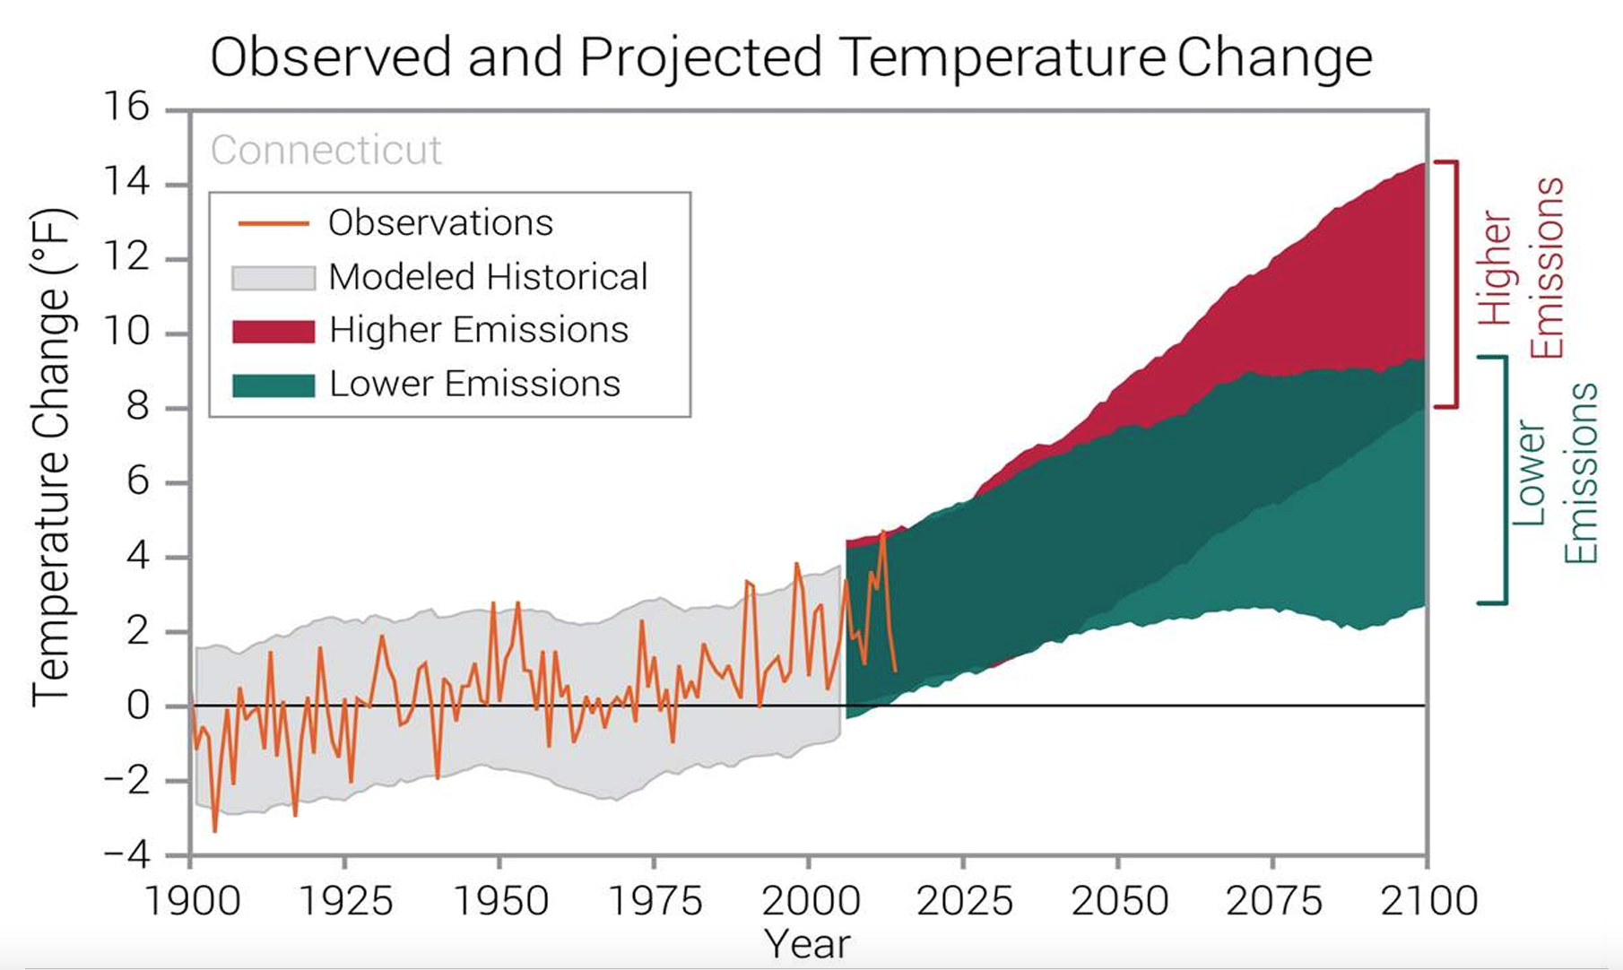
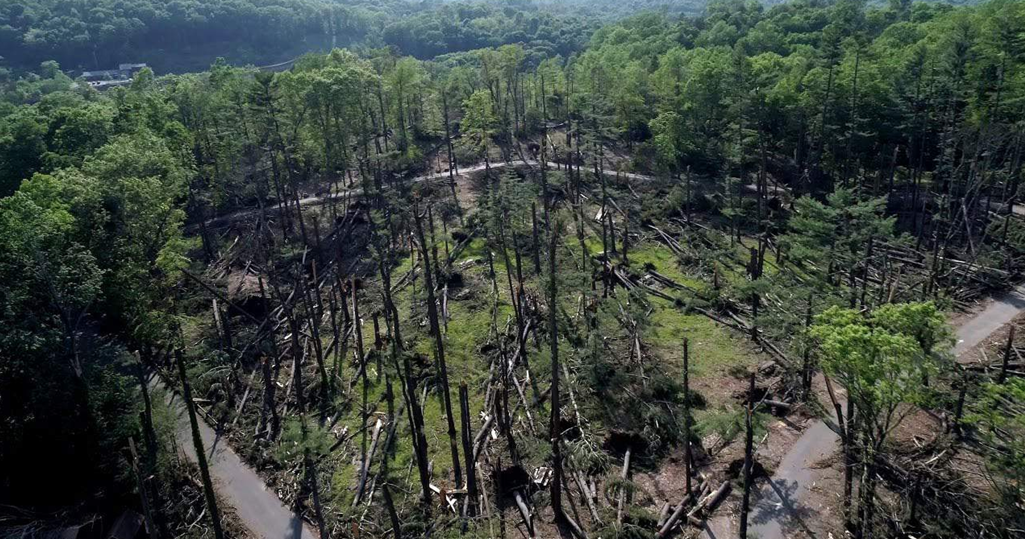
Climate Impacts in New England
Elevated temperatures
Longer growing seasons
Changes in precipitation patterns
More droughts and heat waves
More intense and frequent storm events
Sea level rise
Increase in invasive pests & pathogens
NOAA
Sleeping Giant State Park

Slide 9
Climate Smart Land Stewardship
Mitigation - reducing or removing greenhouse gas (GHG) emissions, e.g. by increasing carbon sequestration and storage
Resilience - ability of an ecosystem to withstand or respond quickly to disturbance and return to a prior condition
Adaptation - actions that intentionally accommodate change and allow ecosystems to respond to future conditions
Notes:
EXAMPLES:
Mitigation - increasing carbon storage through things like reducing tillage on farms to store soil carbon, or planting trees to sequester carbon.
Resilience - diversification of crops, managing forests to increase age & species diversity
Adaptation - planting crops (or trees) that are adapted to warmer climates, or managing forests to promote native species that are more drought tolerant (hickory vs red maple).

Slide 10
Climate Smart Land Stewardship
A collection of strategies and practices that:
Increase the ability of land to sequester and store carbon,
Provide additional ecosystem services,
Withstand disturbances, and
Adapt to changing conditions
Look forward to considering applications from a diversity of landscapes: urban, suburban and rural projects on properties of varying sizes

Slide 11
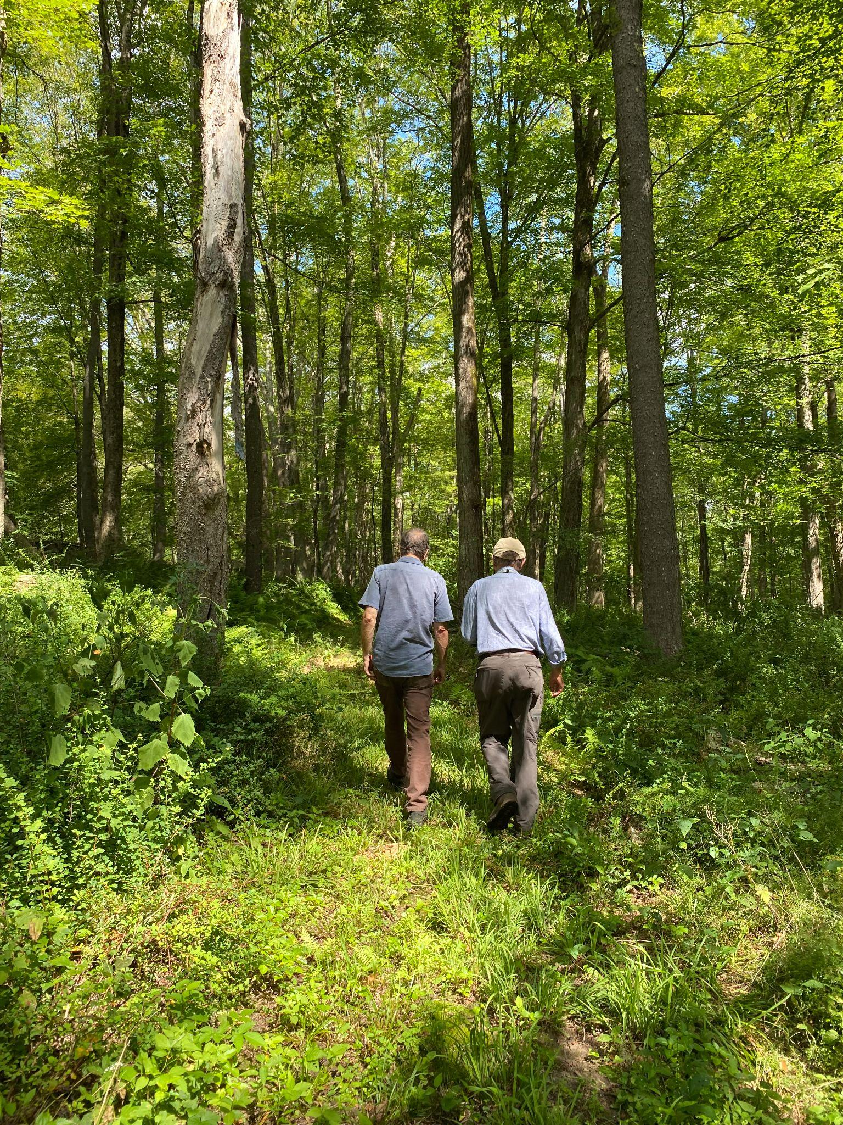
Grant Rounds
First Round: Applications accepted
until March 1, 2024, 5:00pm
Additional rounds in 2024:
May 1
August 1
November 1
Decisions made approximately
~ 6 weeks after the deadline
Cooley Preserve Cornwall Cons.Trust

Slide 12
Eligibility
501(c)3 tax-exempt organization
Mission is dedicated to land conservation and/or stewardship of conserved lands
Service area is located within or includes the State of Connecticut
Project is located within the State of Connecticut on land owned in fee by the applicant
Current member of CLCC

Slide 13
Grant Categories and Funding Tiers
Planning Grants – maximum award $8,000
Early stages of developing a project
Fund background research & plan development needed for future implementation
Implementation Grants – maximum award $50,000
Already have well-developed plan for a project
Fund activities related to on-the-ground implementation
Notes:
RB

Slide 14
Grant Category Comparison
 | PLANNING GRANT | IMPLEMENTATION GRANT
Maximum Award Amount | $8,000 | $50,000
Match Requirement | 25% cash match | None
Project Duration | 1 year | Completed by April 30, 2027
Payment Process | 25% contract signing; 75% project completion | Project-specific, tied to Key Project Milestones
Notes:
Matching funds may be retroactively reimbursed from a planning grant if the LT applies and receives an implementation grant as well.

Slide 15
Eligible Expenses
Consultant or contractor costs for planning and/or implementation
Tool and equipment purchase or rental
Materials
Permit fees
Other project related costs, e.g. staff costs, printing/mailing, training fees are not grant-fund eligible but are welcomed as in-kind match
Notes:
Private forester for forest stewardship plan
Company/operator for seed drill for pollinator meadow, tigercat/forest brush mower
Deer Fence, saplings, seeds

Slide 16
Ineligible Expenses
Expenses incurred prior to grant award and contract execution
Costs related to land acquisition
Services or supplies not directly related to the climate smart project for which funding is awarded

Slide 17
Primary Evaluation Criteria
Project will contribute to climate mitigation, resilience and/or adaptation.
Deliverables, budget and timeline are specific, measurable, and realistic.
Organization and proposed project team have the capacity to execute the project.

Slide 18
Secondary Evaluation Criteria
Project is located in a CT Environmental Justice Community.
Project outcomes are clearly articulated and measurable, with intention & capacity to sustain after the grant period has ended.
Applicant demonstrates organizational commitment to climate change.
Implementation Only Criteria
Applicant provides a strong rationale for the approach they propose.
Project includes a plan for measurement and evaluation of implemented actions.
Notes:
Project will be utilized for additional impacts outside the project area.

Slide 19
Bonus Evaluation Criteria
Project includes partnerships and evidence of landscape-level planning.
Project demonstrates a high degree of innovation and/or creativity.
Project includes matching funds beyond what is required and/or leverages state/federal funding sources such as NRCS EQIP

Slide 20
Post-Award Requirements
Applicants of awarded projects will be responsible for:
Signing a contract with CLCC
Providing a Certificate of Insurance listing CLCC as an additional insured on the grantee’s liability insurance policy
Completing the contract within the specified timeframe
Submitting project reports in the required format
Allowing site inspections of the project site

Slide 21
Reporting
Semi-annual progress reports throughout the contracted project duration
One final report at the conclusion of the contracted project duration
Reports will include:
Documentation of expenditures
Explanation of variations from budget
Explanation of changes to the project and/or timeline
Progress & plans
Challenges & lessons learned
Outreach/engagement activities conducted
Project outcomes and impacts (quantitative and qualitative)

Slide 22
Sample Projects
Climate smart land stewardship can be implemented on many land types
Forests
Meadows & grasslands
Agricultural lands
Rivers, streams & wetlands
Parks & recreation areas
Urban greenspaces
See Natural Resources Conservation Service (NRCS) list of Climate Smart Mitigation Activities

Slide 23
Sample Project - Forest Management
Save Our Forests Land Trust owns an 50-acre parcel that is currently forested with mixed hardwoods. The forest is mostly mature, single-age trees with poor regeneration. It suffers from heavy deer browse and invasive understory species. Save Our Forests has worked with a certified forester to complete a forest management plan that will increase regeneration and increase the structural and species diversity of the forest. They apply for funding to implement this plan, which will take several years and will include selective tree cutting, invasive species removal, deer exclusion, tree and shrub planting and monitoring.
Notes:
Will want to see specific goals of project. Goals can include mitigation (carbon sequestration), resilience (wildlife habitat, increased tree species diversity), adaptation (favoring planting of climate adapted trees). Project will be evaluated on realism of budget, timeline, project team. Want to see organizational support & ability to sustain. Strengthens project to involve volunteers, include public education programs, interpretive signage.

Slide 24
Sample Project - Pollinator Meadow
We Love Bees Land Trust owns a 3-acre non-wooded parcel that is currently degraded by herbaceous and woody invasive species. They worked with a restoration ecologist to complete a plan to restore this site for pollinator habitat. They apply for funding to implement this plan, which will take two years and will include site preparation, meadow establishment and meadow maintenance.
Notes:
Same evaluation criteria - timeline, project team, budget. Also can involve volunteers, signage, public programs. If this same parcel was owned by Save Our Forests, could have applied for reforestation instead - projects should reflect LT goals.

Slide 25
Sample Project - Planning
Preserve Our Places Land Trust recently acquired a 20-acre parcel that includes forest, stream, wetland and some open field areas. The parcel has not been actively managed in many years and most of the habitat has been impacted by deer browse, invasive species, extreme weather and human use. Preserve Our Places does not typically engage in active management, but they are interested in using climate smart stewardship practices to enhance this property. They apply for a planning grant to inform their next steps. Funding will support working with a consultant to develop a management plan that aligns with their goals.
Notes:
What type of consultant to engage depends on property characteristics and land trust goals (inc implementation funding). Most likely forester - can also make riparian recommendations - but if mostly open field or mostly riparian/wetland (e.g. trout habitat), might choose a different professional.

Slide 26
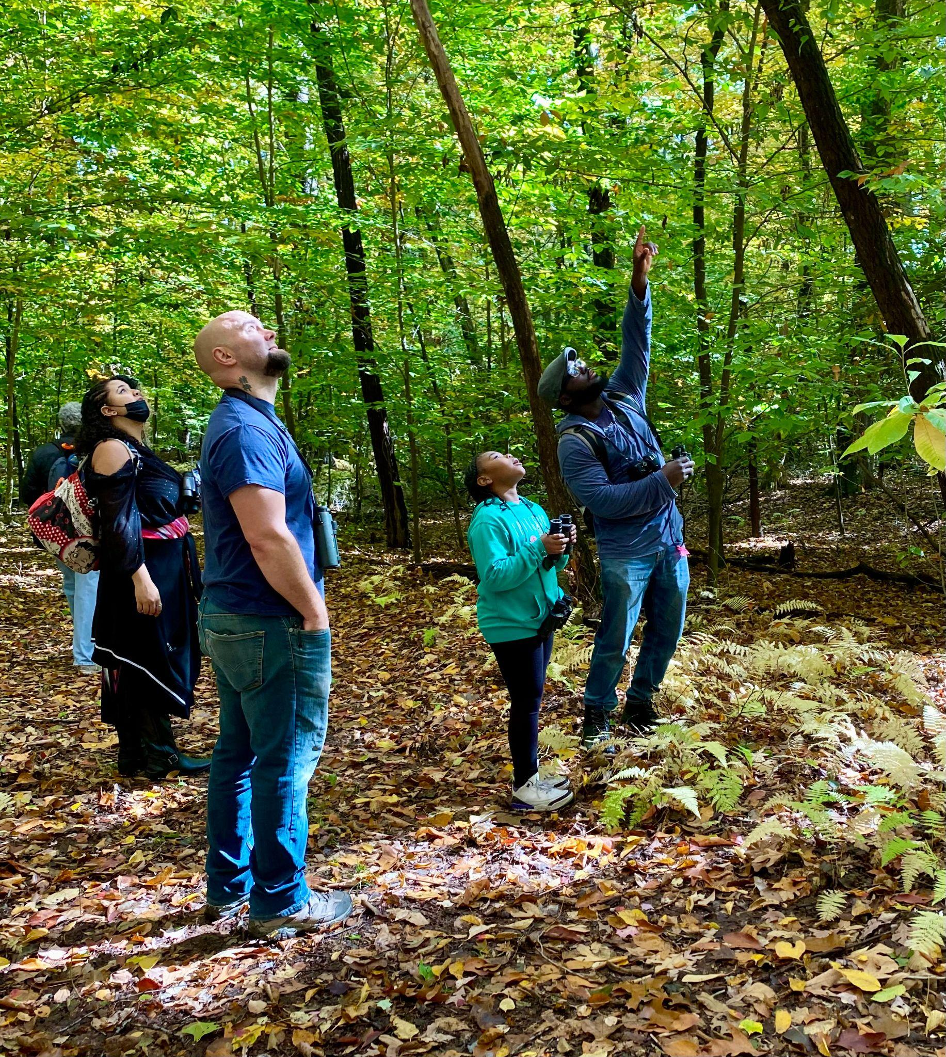
Information & Assistance
Climate Smart Stewardship Coordinator
Schedule conversations and site visits with Ricky
CT DEEP Service Foresters
Website tour
https://ctconservation.org/programs/climate-smart/
Bird and Hike - East Granby LT
Notes:
CSSC is available for Brainstorming opportunities to implement climate-smart practices. Bridge to available resources. Have meetings with. Visit your land trust properties and provide insight about how climate-smart practices could be best incorporated into land stewardship programs & projects
Review existing plans or materials
Service Foresters may spend up to one full day per calendar year with a given landowner for no charge touring property discussing goals, interest and concerns

Slide 27
Thank You!
Contact us with more questions or to set up a site visit!
Ricky Bentley - rbentley@ctconservation.org
Aaron Lefland - alefland@ctconservation.org
Julia Solomon - julia@shadbushconsulting.com - Shadbush Consulting

Slide 28
Questions?

